Slide 1


INDUSTRIAL MANAGEMENT PART 2
© ULTRA CONSERVE PVT. LTD.

Slide 2
ORGANISATION.
SOCIAL UNIT OF PEOPLE SYSTEMATICALLY ARRANGED AND MANAGED TO PURSUE COLLECTIVE GOALS ON CONTUNUING BASIS.
© ULTRA CONSERVE PVT. LTD.

Slide 3
STRUCTRE
MECHANISTIC
ORGANIC
The structure defines position and function.The optimum structure depends on Political, Demogrphic,Sociocultural , Economic,Technological,AND Legal factors.
© ULTRA CONSERVE PVT. LTD.

Slide 4
MECHANISTIC AND ORGANIC
RIGID, WELL DEFINED,BEUROCRATIC,MULTI LEVEL,PYRAMID,LEAST INTERACTIVE AMONG PEERS.
FLEXIBLE, FLAT,INTERACTIVE,MINIMUM DOCUMENTATION,MULTIPLE ROLES,DECENTRALIZED DECISION MAKING.
© ULTRA CONSERVE PVT. LTD.

Slide 5
GREINERS MODEL
ASSUMPTIONS
GROWTH
MANAGEMENT STYLE
STRUCTURE
COORDINATION
© ULTRA CONSERVE PVT. LTD.

Slide 6
TYPES OF SFTRUCTURES
FUNCTIONAL Manufacturing firms
DIVISIONAL Multiple markets
MATRIX Project Based Companies
TEAM BASED Flexibility Innovation
NETWORK Outsourcing Companies
HIERARCHIAL Traditional Stable
FLAT Faster Decisions Collaborative

Slide 7
PHASES OF GROWTH
GROWTH THROUGH CREATIVITY LEADERSHIP CRISIS
GROWTH THROUGH DIRECTION AUTONOMY CRISIS
GROWTH THROUGH DELEGATION CONTROL CRISIS
GROWTH THROUGH COORDINATION RED TAPE CRISIS
GROWTH THROUGH COLLABORATION INTERNAL GROWTH CRISIS
GROWTH THROUGH ALLIANCES IDENTITY CRISIS.
© ULTRA CONSERVE PVT. LTD.

Slide 8
STAGE 1 CREATIVITY
Flat structure
Small and Informal
Entreprenurial
Loyal employees.
ONE MAN SHOW…Not possible
© ULTRA CONSERVE PVT. LTD.

Slide 9
STAGE 2 DIRECTION
Appoint Functional Managers.
Create Middle Management,Rules procedures are standardized, Central coordination with Entrepreneur
Autonomy crisis is Born.
© ULTRA CONSERVE PVT. LTD.

Slide 10
STAGE 3 DELEGATION
Tactical , Operational objectives by middle managers.
Low intervention
Product Group
Individual Managers
Co ordination Difficult Divisional managers plot own course
© ULTRA CONSERVE PVT. LTD.

Slide 11
STAGE 4 COORDINATION
Staff Deparments Introduced… What are staff and line roles?
Take strong position from Headquarters
Manage Divisional managers
Headquarters All important
COMPANY INFLEXIBLE RED TAPE ARISES STAFF DEPT TAKE UP TOO MUCH POWER
© ULTRA CONSERVE PVT. LTD.

Slide 12
STAGE 5 COLLABORATION
Line and Staff Deparment co-ordination
Hierachial forms
Matrix Structure
Consultation Groups
Meetings
Too many Consultations. Supervision Declines…
© ULTRA CONSERVE PVT. LTD.

Slide 13
STAGE 6 ALLIANCES
External alliances
Contacts
Mergers
Extensive Network
Focus on alliances rather than own business.Other businesses take over.Identity Crisis.
© ULTRA CONSERVE PVT. LTD.

Slide 14
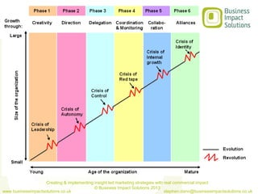
GRAPH
© ULTRA CONSERVE PVT. LTD.

Slide 15
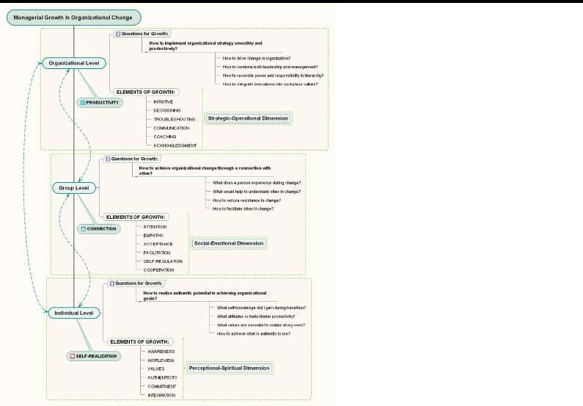
GRAPH 2
© ULTRA CONSERVE PVT. LTD.

Slide 16
ORGANISATIONAL DESIGN
CREATE VALUE FOR FUTURE
PEOPLE AT THE CENTRE
DESIGN IS LIKE A MAP. IMPLEMENTATION GPS
BUILD RESILIENCE FOR UNKNOWN.
NO PERFECT MODEL.
© ULTRA CONSERVE PVT. LTD.

Slide 17
ORGANISATIONAL DESIGN
MISSION
PROCESS
ROLES STRUCTURE
PEOPLE AND PRACTICES
© ULTRA CONSERVE PVT. LTD.

Slide 18
Concept of Internal customers.
Customer is The Focus.
Research.> Development.> Process Design.> Projects.>
Operations.>Marketing.> Final Purchaser.
Multiple Customers. Purchase, Finance and accounts, Personnel,Quality
Assurance, HR,Maintainance, Stores, Security, IT services.
© ULTRA CONSERVE PVT. LTD.

Slide 19
Marketing
Interaction With Others:
R&D
Design & projects.
Operations
Quality assurance
Customer
© ULTRA CONSERVE PVT. LTD.

Slide 20
Marketing
Three Major Areas
New Products
Improving Existing products
Service to the customer
© ULTRA CONSERVE PVT. LTD.

Slide 21
© ULTRA CONSERVE PVT. LTD.

Slide 22
PORTERS VALUE CHAIN MODEL
INTRODUCED IN 1985 BY MICHEL PORTER
Primary Activities- Directly Develop Product or Services.
Support Activities- To make Primary Activities more Efficient
Strategic Management tool.
© ULTRA CONSERVE PVT. LTD.

Slide 23
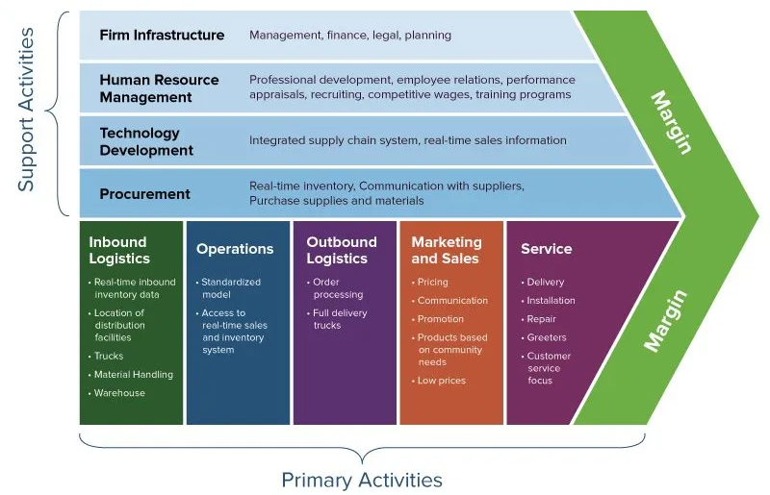

Slide 24
VALUE CHAIN ANALYSIS
COMPETETION
NEW ENTRANTS
BARGAINING POWER OF CUSTOMERS
BARGAINING POWER OF SUPPLIERS
THREAT OF ALTERNATIVES
© ULTRA CONSERVE PVT. LTD.

Slide 25
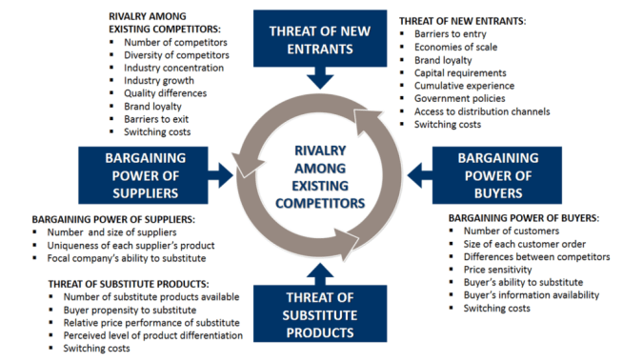
PORTER'S FIVE FORCES IS A FRAMEWORK FOR UNDERSTANDING THE COMPETITIVE FORCES AT WORK IN AN INDUSTRY, AND WHICH DRIVE THE WAY ECONOMIC VALUE IS DIVIDED AMONG INDUSTRY ACTORS.

Slide 26
VALUE CHAIN
PHYSICAL OR TRADITIONAL
VIRTUAL
STRATEGIC BUSINESS UNIT
GLOBAL
© ULTRA CONSERVE PVT. LTD.

Slide 27
EXAMPLES OF INDUSTRIES
WALL MART RELIANCE
AMAZON
FEDEX SPEED POST
BASF
CITI BANK ICICI BANK
ASIAN PAINTS PIDILITE
© ULTRA CONSERVE PVT. LTD.

Slide 28
PORTERS GENERIC STRATEGY
LOWER COST
DIFFERANTIATION.
© ULTRA CONSERVE PVT. LTD.

Slide 29
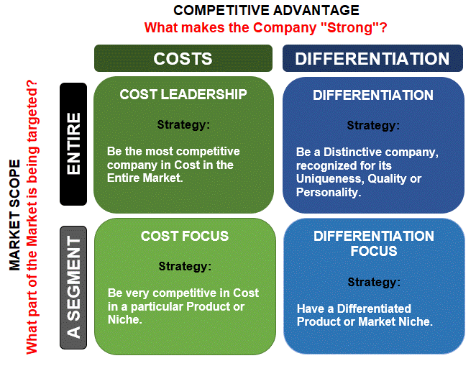

Slide 30
Balance Sheet
Reports assets, liabilities, and equity at a specific point in time
What the company currently holds and owns
The balance sheet is a snapshot that tells you what a company is worth at a single moment

Slide 31
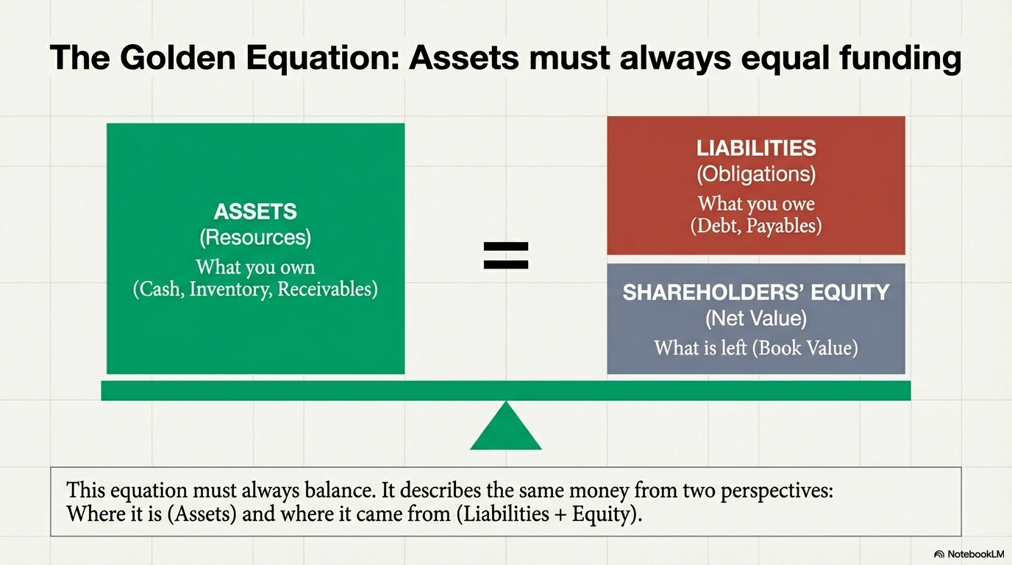

Slide 32
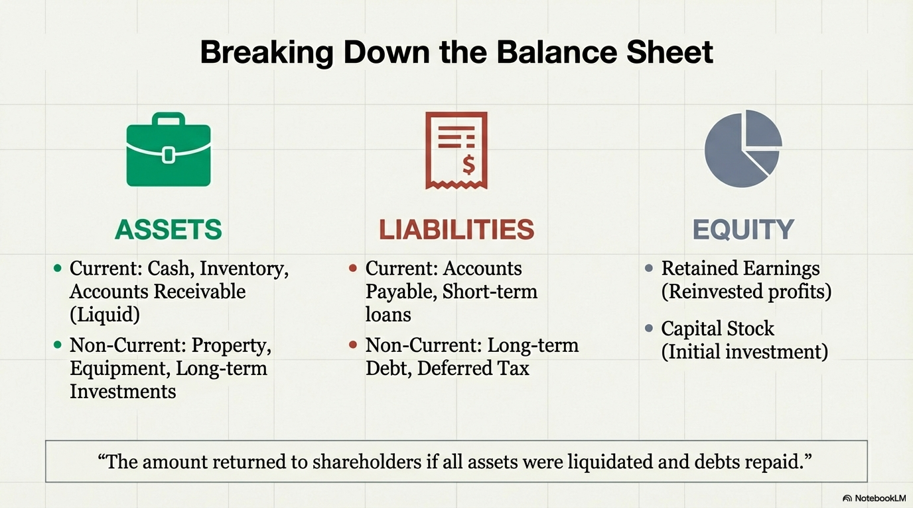

Slide 33
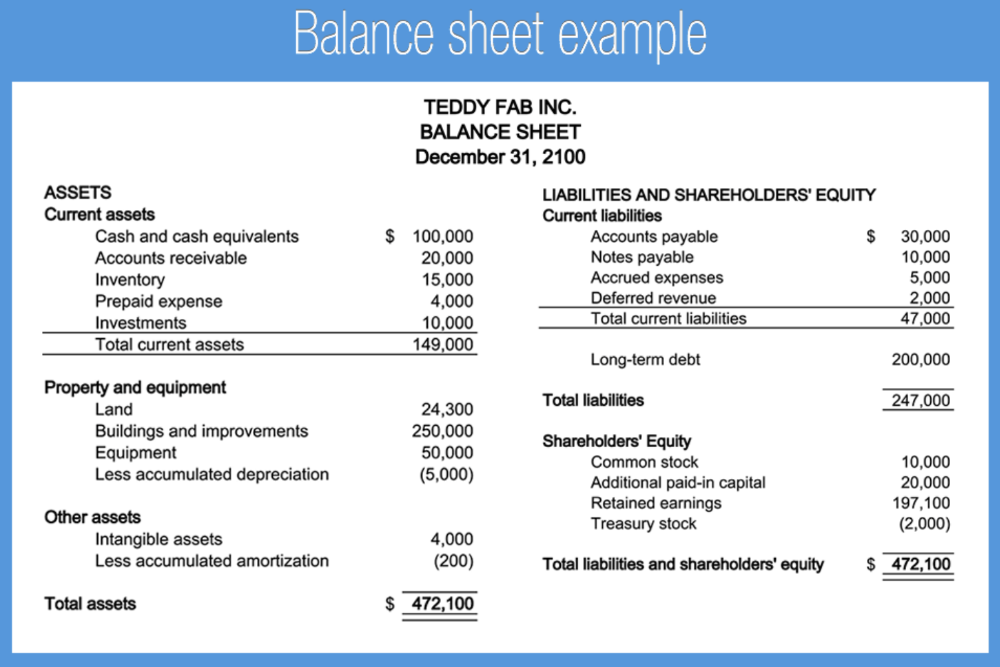

Slide 34
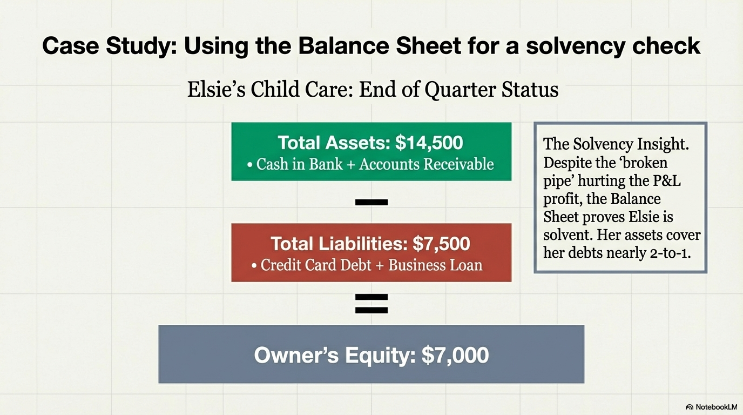

Slide 35
P&L Statement
Summarises the revenues, costs and expenses incurred during a specific period of time
Captures the flow of activity over a period of time like a movie, revealing the story of how it generated profit or incurred loss through its daily operations

Slide 36
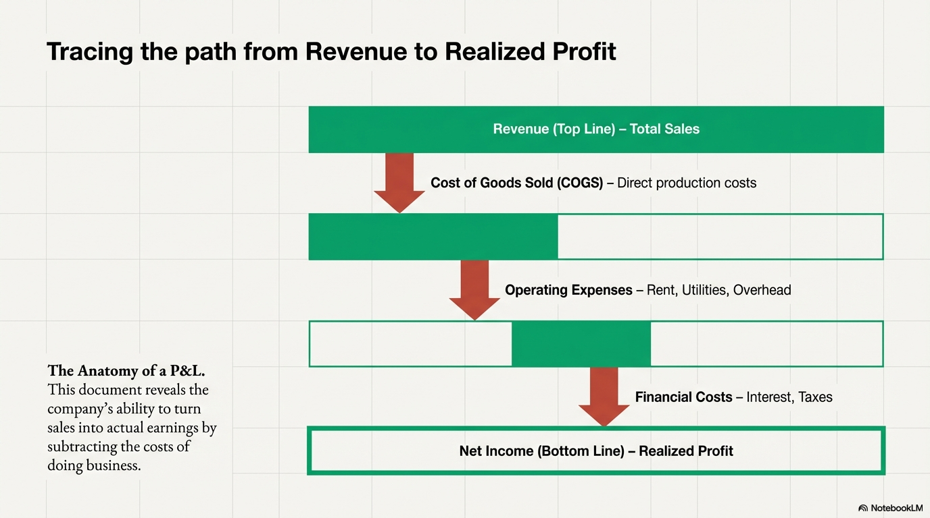

Slide 37
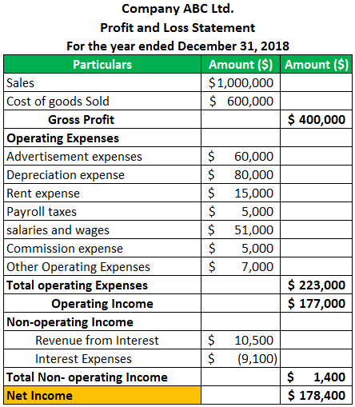

Slide 38
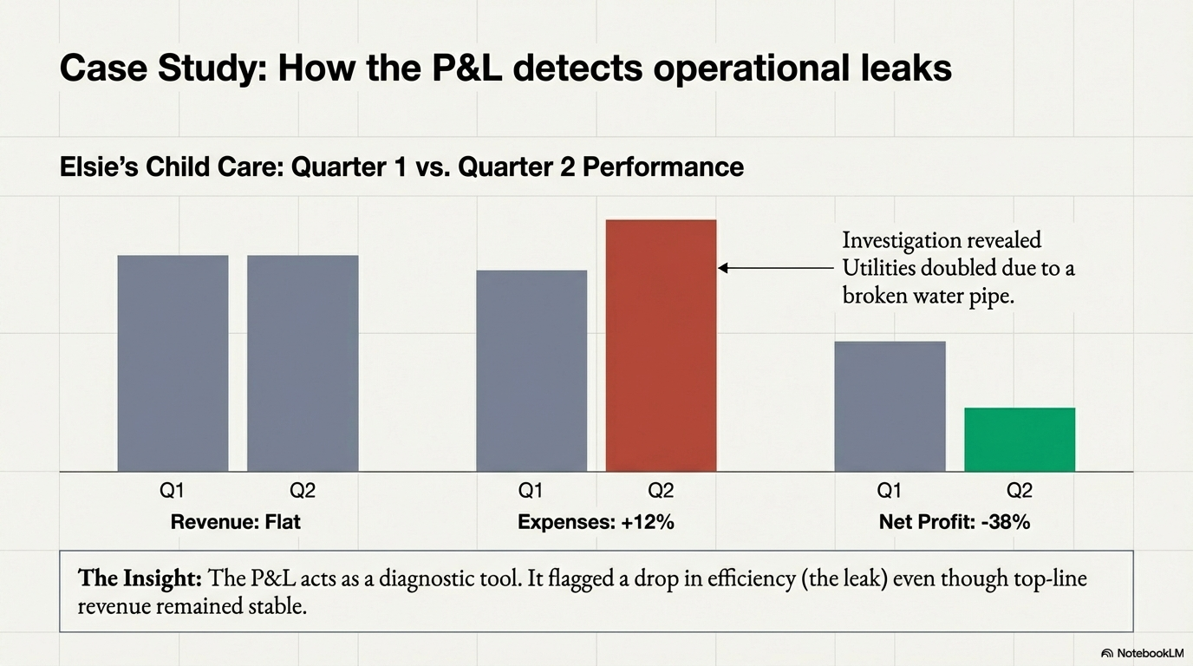

Slide 39
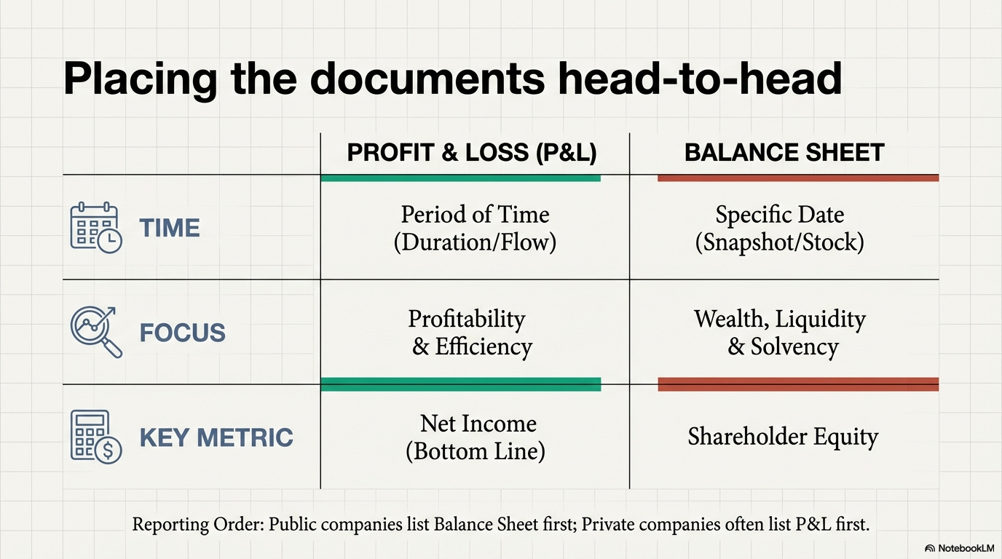

Slide 40
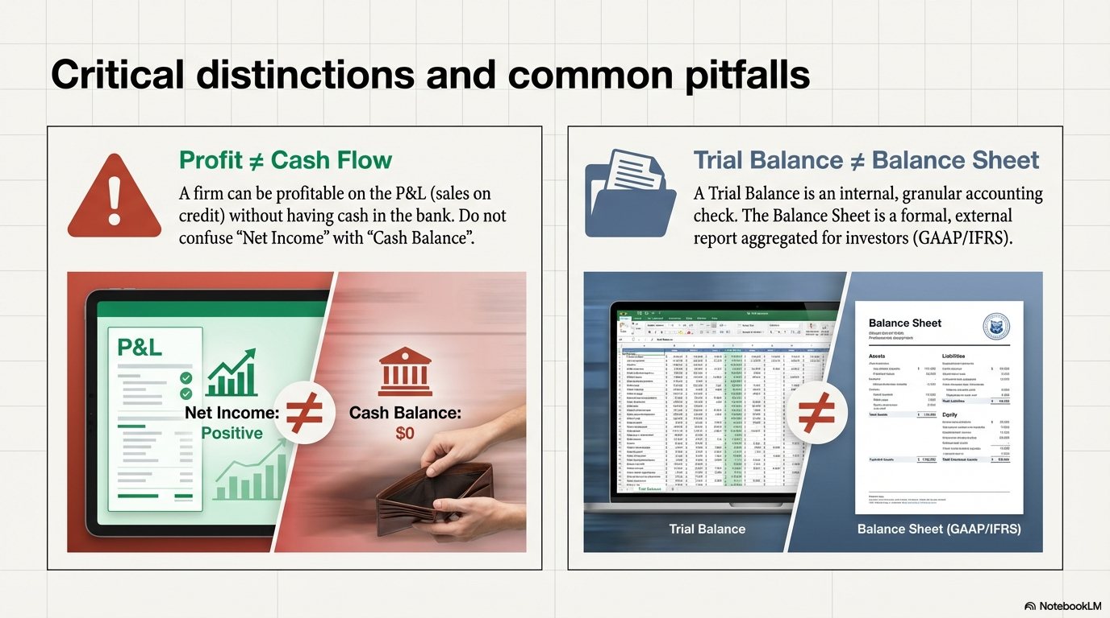

Slide 41
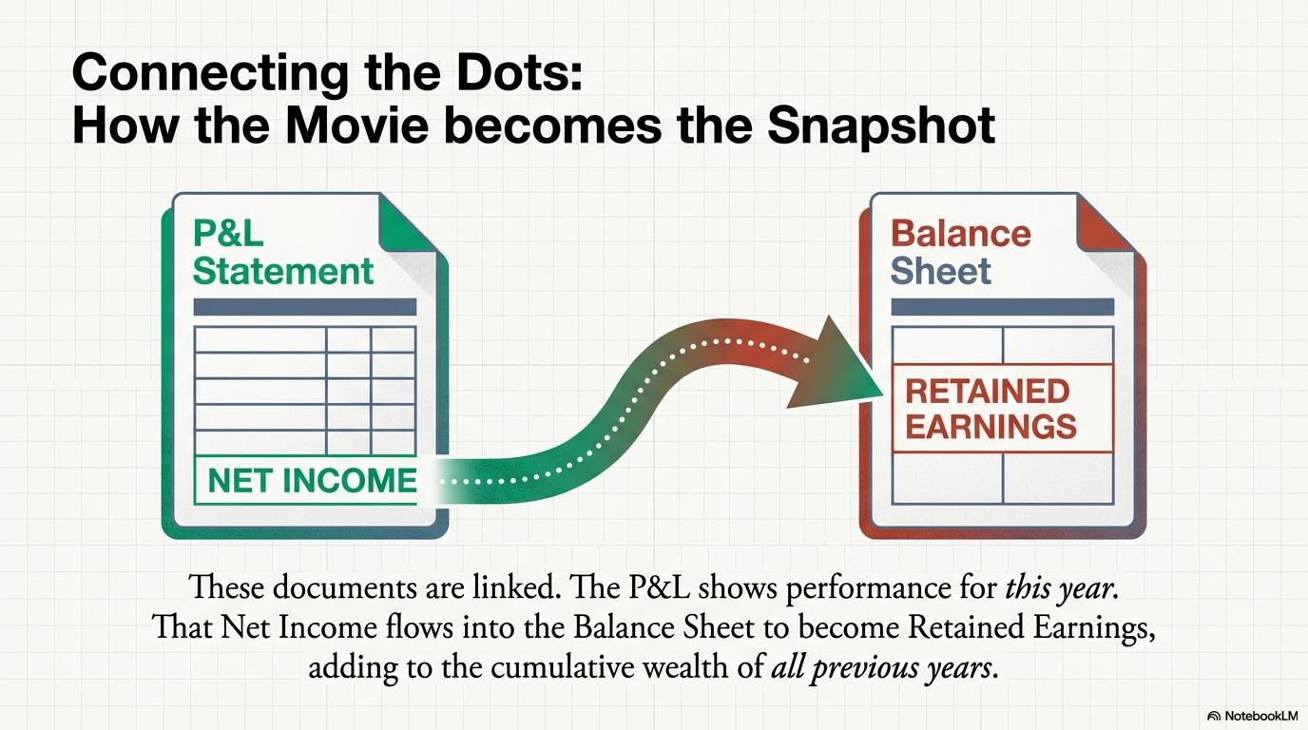

Slide 42
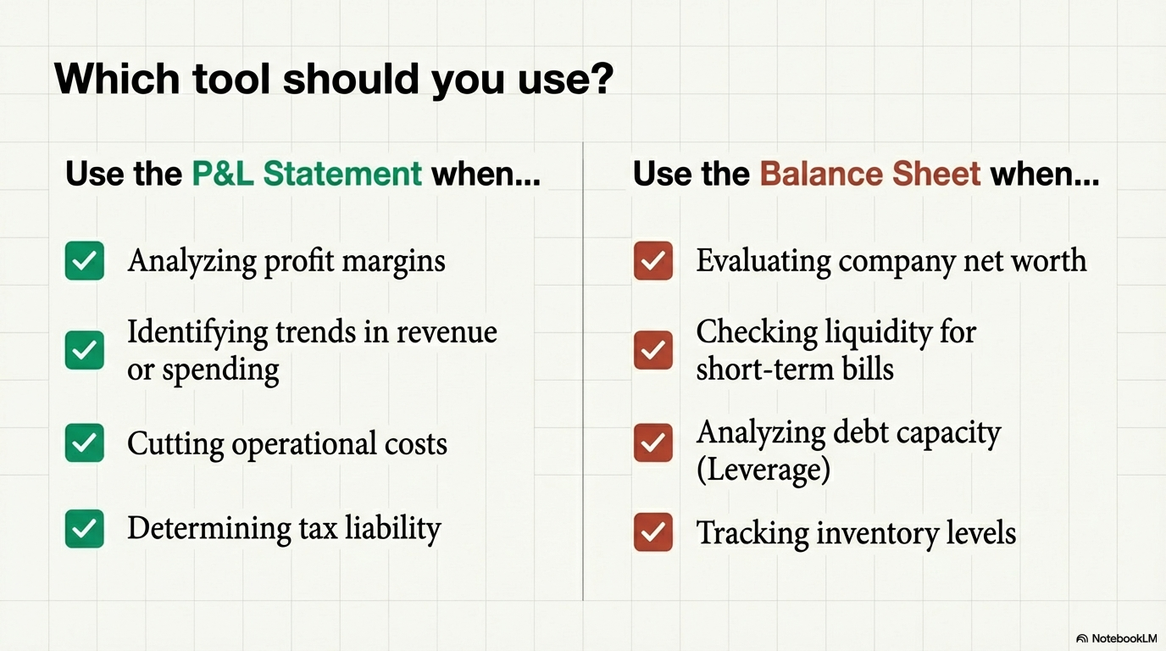

Slide 43
References
https://www.investopedia.com/ask/answers/121514/what-difference-between-pl-statement-and-balance-sheet.asp
https://youtu.be/_dANzaInfvA?si=QzC0SfYsTZ9JOz4M

Slide 44
FINANANCE AND ACCOUNTS
BUDGET
DEFICIT BUDGET AND WHAT IT MEANS
CAPITAL AND REVENUE EXPENDITURE
DEPRECIATION AND INCOME TAX
These compromises might play out differently if the time period or time cycles are affected.
To Sum up there are no specific rules for effects of scale up.
The judgement of the Engineers and Chemists should be considered for factors affecting scale up
AND
All the parameters independently verified through experiments in lab or Pilot Plant
© ULTRA CONSERVE PVT. LTD.

Slide 45
FINANCE AND ACCOUNTS
SURPLUS BUDGET
PROFIT AFTER TAX
CARRY OVER OR DISDURSAL
EBIDTA
© ULTRA CONSERVE PVT. LTD.

Slide 46
INVESTMENT DECISIONS
TECHNICAL EVALUATION.
FEASIBILITY
ABILITY
COMPETETION
NOVELTY
DIFFERRACIATION OR LOW COST
GRASS ROOT OR EXISTING INFRASTRUCTURE
© ULTRA CONSERVE PVT. LTD.

Slide 47
UNVESTMENT DECISIONS
LOCATION
LAND ACQUISITION
OTHER HISTORICAL AND GEOGRAPHICAL FACTORS
AVAILIBILITY OF MANPOWER
ENVIRONMENTAL CLEARANCE.
OTHER RULES AND REGULATIONS.
CONSISTENCY WITH COMPANY PHILOSOPHY AND
CULTURE
© ULTRA CONSERVE PVT. LTD.

Slide 48
INVESTMENT DECISIONS
RETURN ON INVESTMENT
AVAILIBILITY OF CASH FLOW.
BANKS NBFCs OR OTHER INSTITUTIONS.
BACKWARD AREA BENEFITS
TIME FRAME OF MONEY REQUIREMENT.
OPPORTUNITY COST.
© ULTRA CONSERVE PVT. LTD.

Slide 49
PRODUCT LIFE CYCLE
Estimation.
Competetion.
External factors
Tie up with prospective customers
© ULTRA CONSERVE PVT. LTD.

Slide 50
RISK ANALYSIS
Evaluate And Quantify.
Do or Die category.
Environmental Impact
Sustainability.
Intangibles- Patents,Value addition,Market Reputation.
Opportunity cost.
© ULTRA CONSERVE PVT. LTD.

Slide 51
ACCOUNTING SYSTEMS
Tracking Expenditure
Single Entry
Double entry
Manual ( Redundant)
Computerised.
Companywide Software.
© ULTRA CONSERVE PVT. LTD.

Slide 52
STEP COSTING DIAGRAM
© ULTRA CONSERVE PVT. LTD.

Slide 53
Project Planning

Slide 54
CONTROLLING EXPENDITURE
Monitoring Expenditure:
Bar chart of Expenditure and activity
Review of costs if required
Prepare statements for accounts & Loan disbursal
Control over runs beyond contingencies
© ULTRA CONSERVE PVT. LTD.

Slide 55
QUALITY SYSTEMS
A SYSTEM IS A GROUP OF INTERACTING OR INTERRELATED ELEMENTS THAT ACT ACCORDING TOA SET OF RULES TO FORM A UNIFIED WHOLE.
© ULTRA CONSERVE PVT. LTD.

Slide 56
QUALITY
QUALITY IS NOT THE RESPOSNSIBILITY OF A PARTICULAR SET OF PERSONNEL KNOWN AS QC OR QA
BUT
A RESULT OF THE ENTIRE ORGANISATION FOLLOWING THE STIPULATED SYSTEM.
© ULTRA CONSERVE PVT. LTD.

Slide 57
QUALITY SYSTEMS
ANY QUALITY SYSTEM
ISO 14000 OR SIMILAR REQUIRES.
DEFINATION OF INPUTS
PROCESS
OUTPUT
AND
FEEDBACK
© ULTRA CONSERVE PVT. LTD.

Slide 58
Control of inputs:
Process ,Log sheets, control tests. R.M Specification, operation
manual
Equipment, Manpower skilled & semiskilled
Targets- yearly, Monthly, Daily
© ULTRA CONSERVE PVT. LTD.

Slide 59
OPERATIONS
Control of process:
Carry out process as per S.O.P
Annual plan-Monthly plan-weekly plan-Daily Plan-Hourly Plan- What needs to be done now?
Define immediate action
Device own monitoring systems and plan personal schedule
Verify :
Daily reports
Log sheet
Batch sheets
© ULTRA CONSERVE PVT. LTD.

Slide 60
OPERATIONS
Monitor Output:
Remember Monitor Not Control
Output Quality is a result of me meticulous follow up of S.O.P
Prepare Statistical records
Use of fuzzy logic
© ULTRA CONSERVE PVT. LTD.

Slide 61
OPERATIONS
Safety :
People – Beware of daredevils & alarmists
Environment
Equipment
© ULTRA CONSERVE PVT. LTD.

Slide 62
OPERATIONS
Reports:
Daily, weekly, monthly, annual reports are written at Appropriate levels of hierarchy
Should contain financial numbers
Should contain safety record
Should contain reviews
© ULTRA CONSERVE PVT. LTD.

Slide 63
OPERATIONS
Interactions:
1. Purchase :
To decide stock levels, Decide Availability & shortage and fluctuation in prices
2. Maintenance :
To decide availability of manpower & equipment
© ULTRA CONSERVE PVT. LTD.

Slide 64
OPERATIONS
Control of Effluents :
Segregation
Chemical treatment
Biological treatment
Post treatment
© ULTRA CONSERVE PVT. LTD.

Slide 65
OPERATIONS
Control of Costs:
Raw Material
Utilities
Maintenance
Comparison and preparing and revising norms
© ULTRA CONSERVE PVT. LTD.

Slide 66
OPERATIONS
Statutory Requirements:
Excise
Sales tax
Director industrial health & Safety
Effluent control board
Labor Departments
© ULTRA CONSERVE PVT. LTD.

Slide 67
OPERATIONS
Working capital Requirement:
Define & Control
Finished Goods Stocks
Raw material stocks
Goods in process & thereby define working capital
© ULTRA CONSERVE PVT. LTD.

Slide 68
OPERATIONS
Improvement in process:
Adequate data
Statistical analysis
Interaction with design ,R&D
Define changes & authorization
© ULTRA CONSERVE PVT. LTD.

Slide 69
OPERATIONS
ISO Applicability:
Inputs
Process
Outputs
Importance can not be understated
© ULTRA CONSERVE PVT. LTD.

Slide 70
MARKETING
Marketing:
Some misconception
Marketing and Sales
Customer base
© ULTRA CONSERVE PVT. LTD.

Slide 71
MARKETING
Plans for Marketing:
Immediate ( Upto 3 Months)
Short term (1 year)
Long term ( 3-5 years)
Plan should include tonnages as well as revenges & budgets
© ULTRA CONSERVE PVT. LTD.

Slide 72
MARKETING
Information:
Products & Services
Uses
Specifications
Availability
Packaging
Regulatory issues
© ULTRA CONSERVE PVT. LTD.

Slide 73
MARKETING
Pricing:
Based on
Opportunity
Cost Based
Distress sale
© ULTRA CONSERVE PVT. LTD.

Slide 74
MARKETING
Customers & Competitor
Know your customers
Policies
Difficulties
Requirements
Competitor
Products
Pricing
Strength & weakness
Practices.
© ULTRA CONSERVE PVT. LTD.

Slide 75
MARKETING
Interactions:
R & D for new products
Operations for plans/stocks
Sales for logistics
© ULTRA CONSERVE PVT. LTD.

Slide 76
MARKETING
Information Gathering:
Library best source
Trade fares
Internal meetings
Academic institutions
Develop own networking
© ULTRA CONSERVE PVT. LTD.

Slide 77
MARKETING
Remember
You are
Face of the company
Control your Budget & overheads
Do not show off
Do not underwrite other Depts./personal
© ULTRA CONSERVE PVT. LTD.

Slide 78
MARKETING
Inputs :
Production plan
Product information / produces
Pricing Guidelines
Customer details
Outputs:
Marketing plan
Review addition of customers
Increase in sales , revenue
© ULTRA CONSERVE PVT. LTD.

Slide 79
CAREER CHOICE
It is normal to be uncertain
Do not follow the crowd
Is the interest in lighter studies genuine
It is never too late to change
Higher studies ? In which held, Job? In which field
© ULTRA CONSERVE PVT. LTD.

Slide 80
WRITING AN SOP
Be Honest & Realistic
State what you feel not What you should feel
A little uncertainty is not bad
State what you intend to achieve through higher education
Use understand language and informal narrative
© ULTRA CONSERVE PVT. LTD.

Slide 81
Appearing for an interview :
Get information about company & its product
For R& D be ready with some thoughts for the organization
Define what you think you will be required to do & contribute
Do not ask too many queries about locations and transfers
Do not be worried about slightly lower salary
Ask questions
© ULTRA CONSERVE PVT. LTD.

Slide 82
Some Soft skills:
Motivation- Maslow's theory
Communication- Johari window
Leadership –styles
Getting along with people –How ? , Why?
Recognizing Oneself
© ULTRA CONSERVE PVT. LTD.

Slide 83
TOXICITY
Toxicity of chemicals
Concept of selective toxicity
Types of Toxicity
Oral
Inhalation
Dermal
Neurotoxicity
Carcinogens
Teratogenicity
© ULTRA CONSERVE PVT. LTD.

Slide 84
TOXICITY
TOXICITY :
Acute & Subacute toxicity
Impact of the above in working life
© ULTRA CONSERVE PVT. LTD.

Slide 85
TOXICITY
Toxicity Of Chemicals:
Relation between
Toxicity & physical properties
Toxicity & Corrosivity
General Antidotes
Flammability flash point & its impact on chemical process
Residues and Persistence –Why both are important
Metabolism in human body’
Aquatic toxicity and toxicity to honey bees
Long term precautions in chemical industry
Do not be afraid &Do not be a daredevil
Trust your instinct
Take simple precautions
© ULTRA CONSERVE PVT. LTD.

Slide 86
TOXICITY
Methods of Disposal of toxic chemicals:
Transportation
Storage
Handling
© ULTRA CONSERVE PVT. LTD.

Slide 87
!! THANK YOU !!
© ULTRA CONSERVE PVT. LTD.

